Slide 1
“FABRICATION OF WATER SPRINKLER AND PESTICIDES SPRAYER ”
Mini Project – III (20ECL59B)
C Tharun Sai Yadav 1NH20EC035
Vimarsha Rudresh 1NH20EC183
Guided By
Dr. Arun Kumar
Associate Professor
Dept. of ECE
New Horizon College of Engineering, Bengaluru
11/28/22

Slide 2
Contents
Introduction
Literature Review
Existing System
Problem Statement & Objectives
Proposed System
Block Diagram
Hardware & Software Specification
References
Progress Work
Milestones/Schedule/Timeline
11/28/22

Slide 3
Introduction
The fabrication of a water sprinkler and pesticides sprayer remote control car involves designing and building a vehicle that can be controlled remotely and has the capability to spray water and pesticides.
This involves creating a sturdy chassis and assembling a control system that includes a remote control, receiver, and motors.
The vehicle will need to be equipped with a water tank and spraying mechanism for the sprinkler and a tank and spraying nozzle for the pesticides.
This type of remote control car can be used for agricultural or landscaping purposes.
11/28/22

Slide 4
Literature Review
Title of the paper | Author & Year of Publication | Outcome | Limitation
FABRICATION OF SOLAR WATER SPRINKLER ROBOT | Mayuresh Wankhede, Ashwini Chikhalkar, Bhavana Gajakush, Varsha Devare, Prof. H.R. Nehete05/May-2022 | Workload on the farmers is decreased and health problems also. Successful in constructing robot which can be travelled on rough, uneven surfaces also and weighing enough load of pump and other equipment. | 1) High initial costs for material and installation and long ROI. 2) Needs lots of space as efficiency is not 100% yet.
Design and Fabrication of Solar based Bluetooth Controlled Pesticide Sprayer | Akshay kumar S, K Nikhil Sai, Amith Raju GS, Abhishek N, Manjunath CMay 2020 | control of vehicle is user friendly and it is not very complicated using bluetooth ; hence farmers can easily control the vehicle. Pesticide spraying is a tedious job in agriculture as it requires various protection equipment’s to protect the farmers. | This circuit used only for pesticide ,but in our project both pesticide and irrigation
Design and Implementation of Pesticide Spraying Robot using IOT | Ravi Gorapudi, Bhargava Rama Sai Pavan Rudrapaka, Aadi Seshu Valluri15 June 2020 | A smart robot system spraying pesticides is controlled through a remote option in an alternative to manual fulfillment of cross spray, lessening direct contact to pesticides. | Task can be improved by utilizing a sensor to take note of the soil ph value such that use of unnecessary Fertilizers can be reduced.
11/28/22

Slide 5
Existing System
Surface irrigation
Water is distributed over and across land by gravity , no mechanical pump involved.
Localized irrigation
Water is distributed under low pressure, through a piped network and applied to each plant.
Drip irrigation
A type of localized irrigation in which drops of water are delivered at or near the root of plants . In this type of irrigation, evaporation and runoff are minimized
Manual irrigation
Water is distributed across land through manual labor and watering cans. This system is very labor intensive.
11/28/22

Slide 6
Problem Statement & Objectives
Problem Statement:
The existing irrigation system, designed decades ago, is outdated and inefficient, leading to water wastage, uneven distribution, and decreased agricultural productivity. There is a pressing need to modernize the system with advanced technologies to ensure sustainable water management and optimize crop yield for the growing agricultural demands.
Objectives:
The objective of this project is to design and build a remote control car capable of spraying water and pesticides, with the aim of improving efficiency and reducing manual labor in agricultural and landscaping tasks. The vehicle should be reliable and easy to control, while also ensuring safety and minimizing environmental impact.
11/28/22

Slide 7
Proposed System
The proposed system is a remote control car equipped with a water tank and spraying mechanism for irrigation purposes and a separate tank and spraying nozzle for pesticide application. The vehicle will be controlled via a remote control, with a reliable and sturdy chassis to ensure stability and durability. The system will be designed with safety features in mind, and the use of pesticides will be regulated to minimize environmental impact. The goal of this system is to improve efficiency and reduce manual labor in agricultural and landscaping tasks.
11/28/22

Slide 8
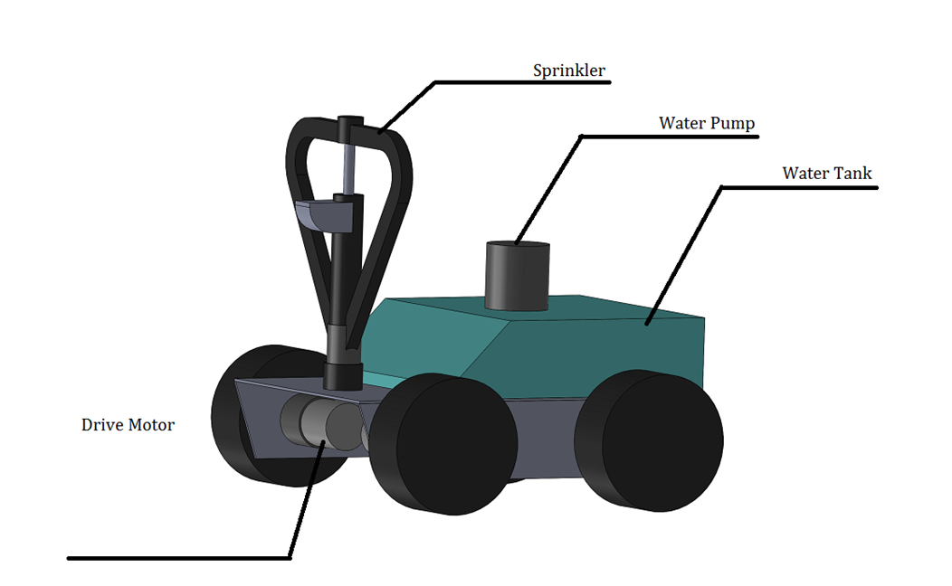
Block Diagram
11/28/22

Slide 9
Hardware & Software Specification
Hardware Components
Sprinkler
Dc Motor
Battery
Pump Motor
Water Tank
Wheels
Remote control vehicle
11/28/22

Slide 10
References
B.C. Wolverton, Anne Johnson, and Keith Bounds, “Interior Landscape Plants for Indoor Air Pollution Abatement: Final Report”, National Aeronautics and Space Administration ( NASA-TM-101768) Science and Technology Laboratory, Stennis Space Center, 1989.
E.J. Van Henten, J. Hemming, B.A.J. Van Tuijl, J.G. Kornet, J. Meuleman, J. Bontsema and E.A. Van Os; “An Autonomous Robot for Harvesting Cucumbers in Greenhouses”; Autonomous Robots; Volume 13 Issue 3, November 2002.
Kevin Sikorski, “Thesis- A Robotic PlantCare System”, University of Washington, Intel Research, 2003.
Ayumi Kawakami, Koji Tsukada, Keisuke Kambara and Itiro Siio, “PotPet: Pet-like Flowerpot Robot”, Tangible and Embedded Interaction 2011, Pages 263-264 ACM New York, NY, USA, 2011.
Constantinos Marios Angelopoulos, Sotiris Nikoletseas, Georgios Constantinos Theofanopoulos, “A Smart System for Garden Watering using Wireless Sensor Networks”, MobiWac '11 Proceedings of the 9th ACM international symposium on Mobility management and wireless access Pages 167-170 ACM New York, NY,
11/28/22

Slide 11
Progress Work
11/28/22

Slide 12
Milestones/Schedule
Milestone | Baseline Date | Target Date | Achievement
11/28/22

Slide 13
Thank You
11/28/22

